Slide 1
LAB - 02
陳培殷
國立成功大學 資訊工程系

Slide 2
Outline
三種電路的表示式
Lab III -1 Constant Multiplier 定數乘法器 x3 & x4
Lab III -2 Comparator 比較器

Slide 3
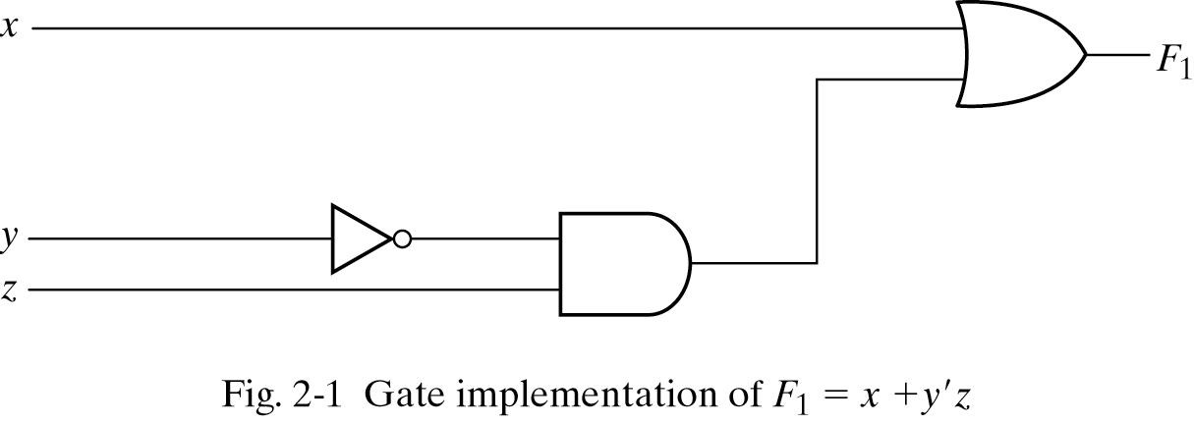
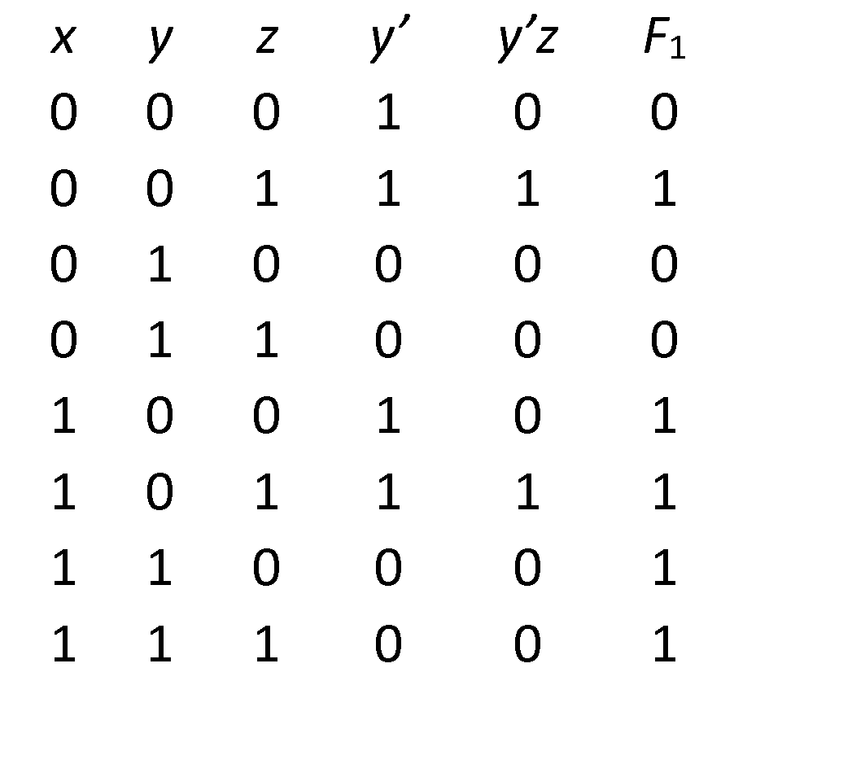
三種電路的表示式
Three representations for a circuit
1. Boolean Algebra
2. Truth Table
真值表
n input variables 🡺 2^{n} combinations
F₁=x+y’z
Inputs
3. Circuit Diagram

Slide 4
Lab 3-1 -- Constant Multiplier (1/3)
There is a 2-bit input X (denoted as X1 and X0). A constant multiplier is designed to multiply the input by 4 & 3. Finally, show the result with decimal format (0, 1, 2, …..,9) on Digital Display in the breadboard.
Hint x4:
The output digital number is 0, 4, 8 , respectively, for four different inputs (0, 1, 2) when mult by 4.
Hint x3:
The output digital number is 0, 3, 6 or 9, respectively, for four different inputs (0, 1, 2, 3) when mult by 3.

Slide 5
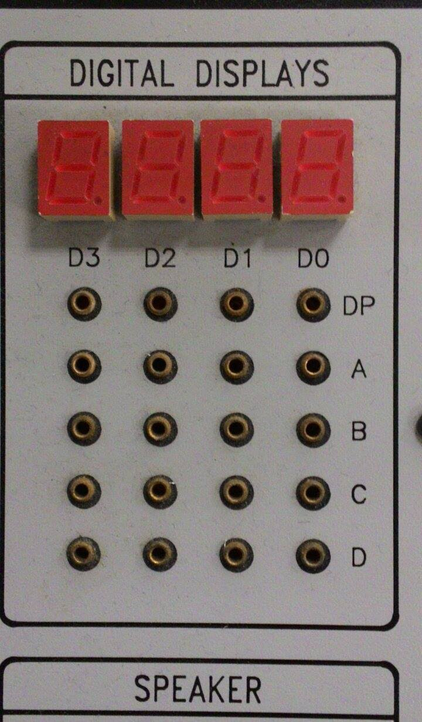
Lab 3-1 -- Constant Multiplier X4 (2/3)
Hint-2:
Function of the Digital Display in the breadboard is as follows.
D | C | B | A | DIGITAL DISPLAY
0 | 0 | 0 | 0 | 0
0 | 0 | 0 | 1 | 1
0 | 0 | 1 | 0 | 2
0 | 0 | 1 | 1 | 3
0 | 1 | 0 | 0 | 4
0 | 1 | 0 | 1 | 5
0 | 1 | 1 | 0 | 6
0 | 1 | 1 | 1 | 7
1 | 0 | 0 | 0 | 8
1 | 0 | 0 | 1 | 9

Slide 6
Lab 3-1 -- Constant Multiplier X3 (2/3)
Hint-2:
Function of the Digital Display in the breadboard is as follows.
D | C | B | A | DIGITAL DISPLAY
0 | 0 | 0 | 0 | 0
0 | 0 | 0 | 1 | 1
0 | 0 | 1 | 0 | 2
0 | 0 | 1 | 1 | 3
0 | 1 | 0 | 0 | 4
0 | 1 | 0 | 1 | 5
0 | 1 | 1 | 0 | 6
0 | 1 | 1 | 1 | 7
1 | 0 | 0 | 0 | 8
1 | 0 | 0 | 1 | 9

Slide 7
Lab 3-1 -- Constant Multiplier (3/3)
Please
(a) draw the truth table of the constant multiplier where two input bits are X1 and X0, and four output bits are A, B, C and D, respectively.
(b) draw the circuit diagram of the constant multiplier.
(c) implement the circuit on the breadboard.

Slide 8
Lab 3-1 -- Constant Multiplier X4(3/3)
(a) draw the truth table of the constant multiplier where two input bits are X1 and X0, and four output bits are A, B, C and D, respectively.
Input Output
X1 | X0 | D | C | B | A
0 | 0
0 | 1
1 | 0
1 | 1
A = 0
B = 0
C = X0
D = X1

Slide 9
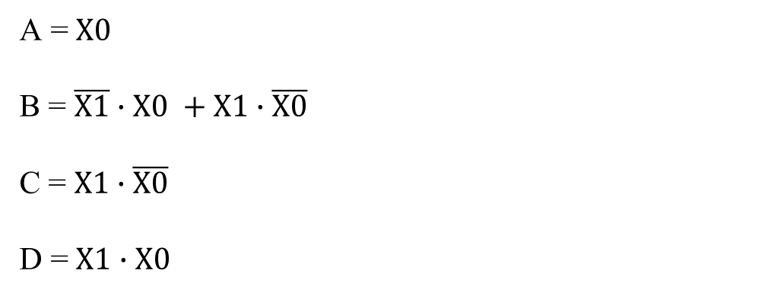
Lab 3-1 -- Constant Multiplier X3
(a) draw the truth table of the constant multiplier where two input bits are X1 and X0, and four output bits are A, B, C and D, respectively.
Input Output
X1 | X0 | D | C | B | A
0 | 0
0 | 1
1 | 0
1 | 1

Slide 10
Lab 3-1 -- Constant Multiplier (3/3)
(b) draw the circuit diagram of the constant multiplier x4 & x3.

Slide 11
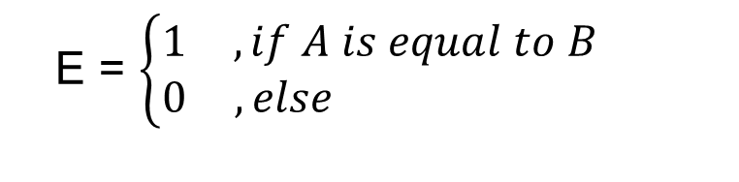
Lab 3-2 – Comparator(1/2)
There are two inputs denoted as A and B. Both A and B are 1-bit value. A comparator is designed to determine whether A is equal to B or not. The output results are represented with E .

Slide 12
Lab 3-2 – Comparator(2/2)
Please
(a) draw the truth table of the comparator.
(b) draw the circuit diagram of the comparator.
(c) implement the circuit on the breadboard.
A | B | F
0 | 0
0 | 1
1 | 0
1 | 1
F(A, B) = (A’B’) + (AB)
F(A, B) = A’B’ + A’B + AB’ + AB

Slide 13
Components needed for LAB III
Names | Amount
Solerless Breadboard | ×1
74LS04 | ×1
74LS08 | ×1
74LS32 | ×1

Slide 14
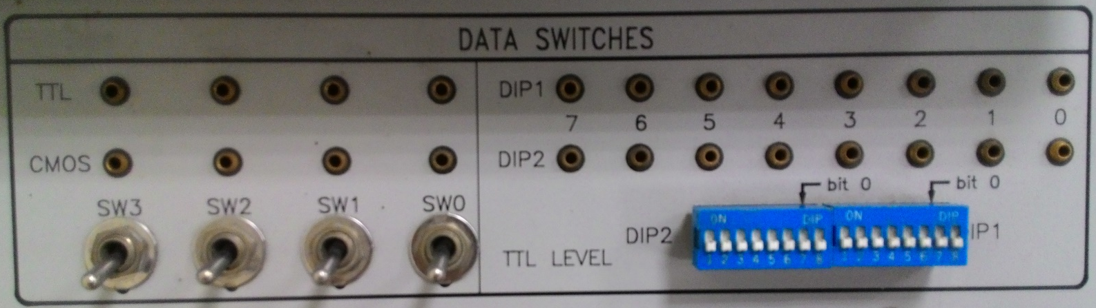
Notice for LAB III
Input
Output
X1
X0
Notes:
錯誤：Input的框框錯(已修正)
七段顯示器容易不穩定

Slide 15
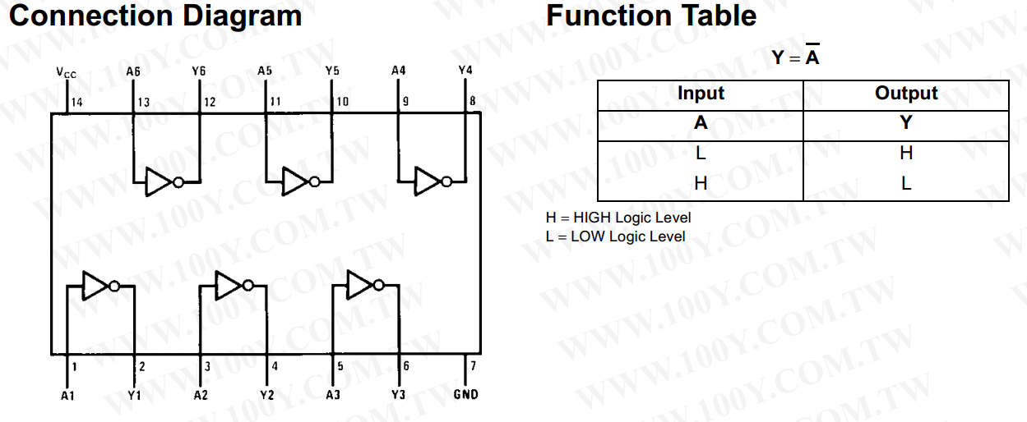
74LS04

Slide 16
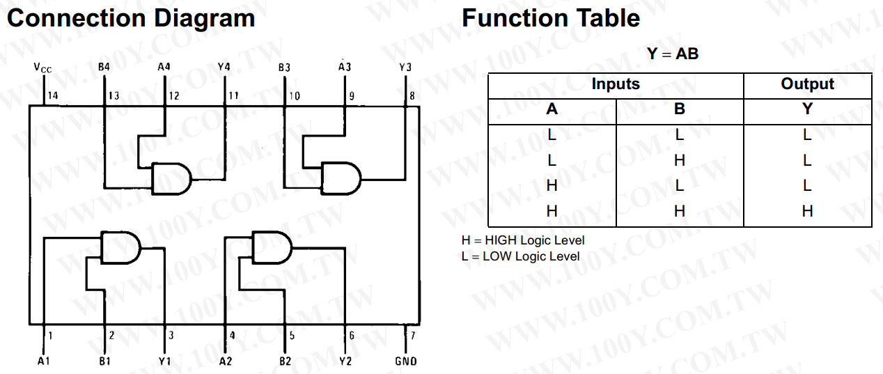
74LS08

Slide 17
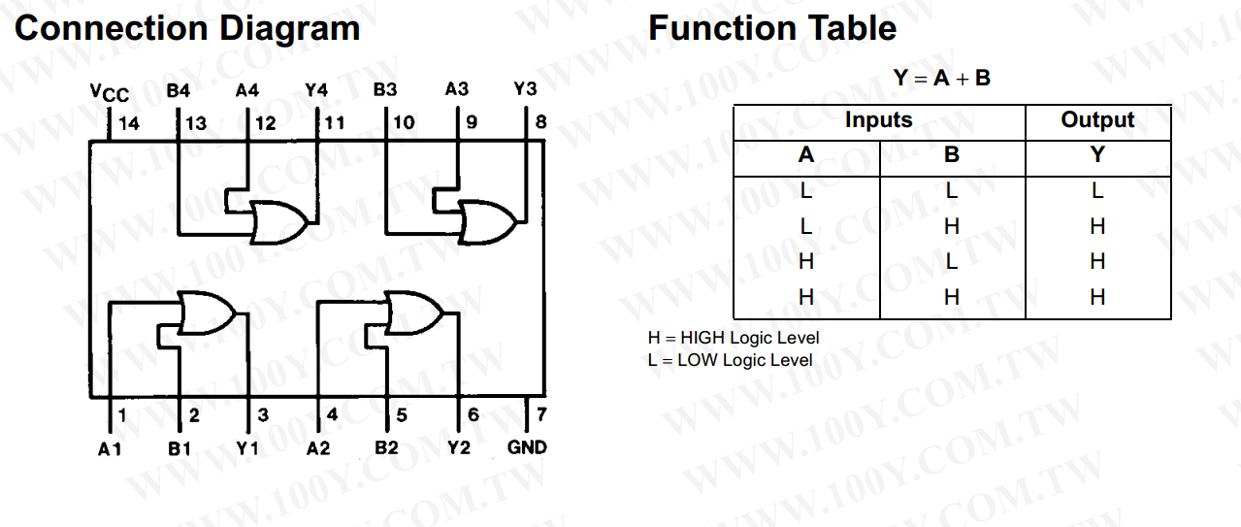
74LS32

